Slide 1
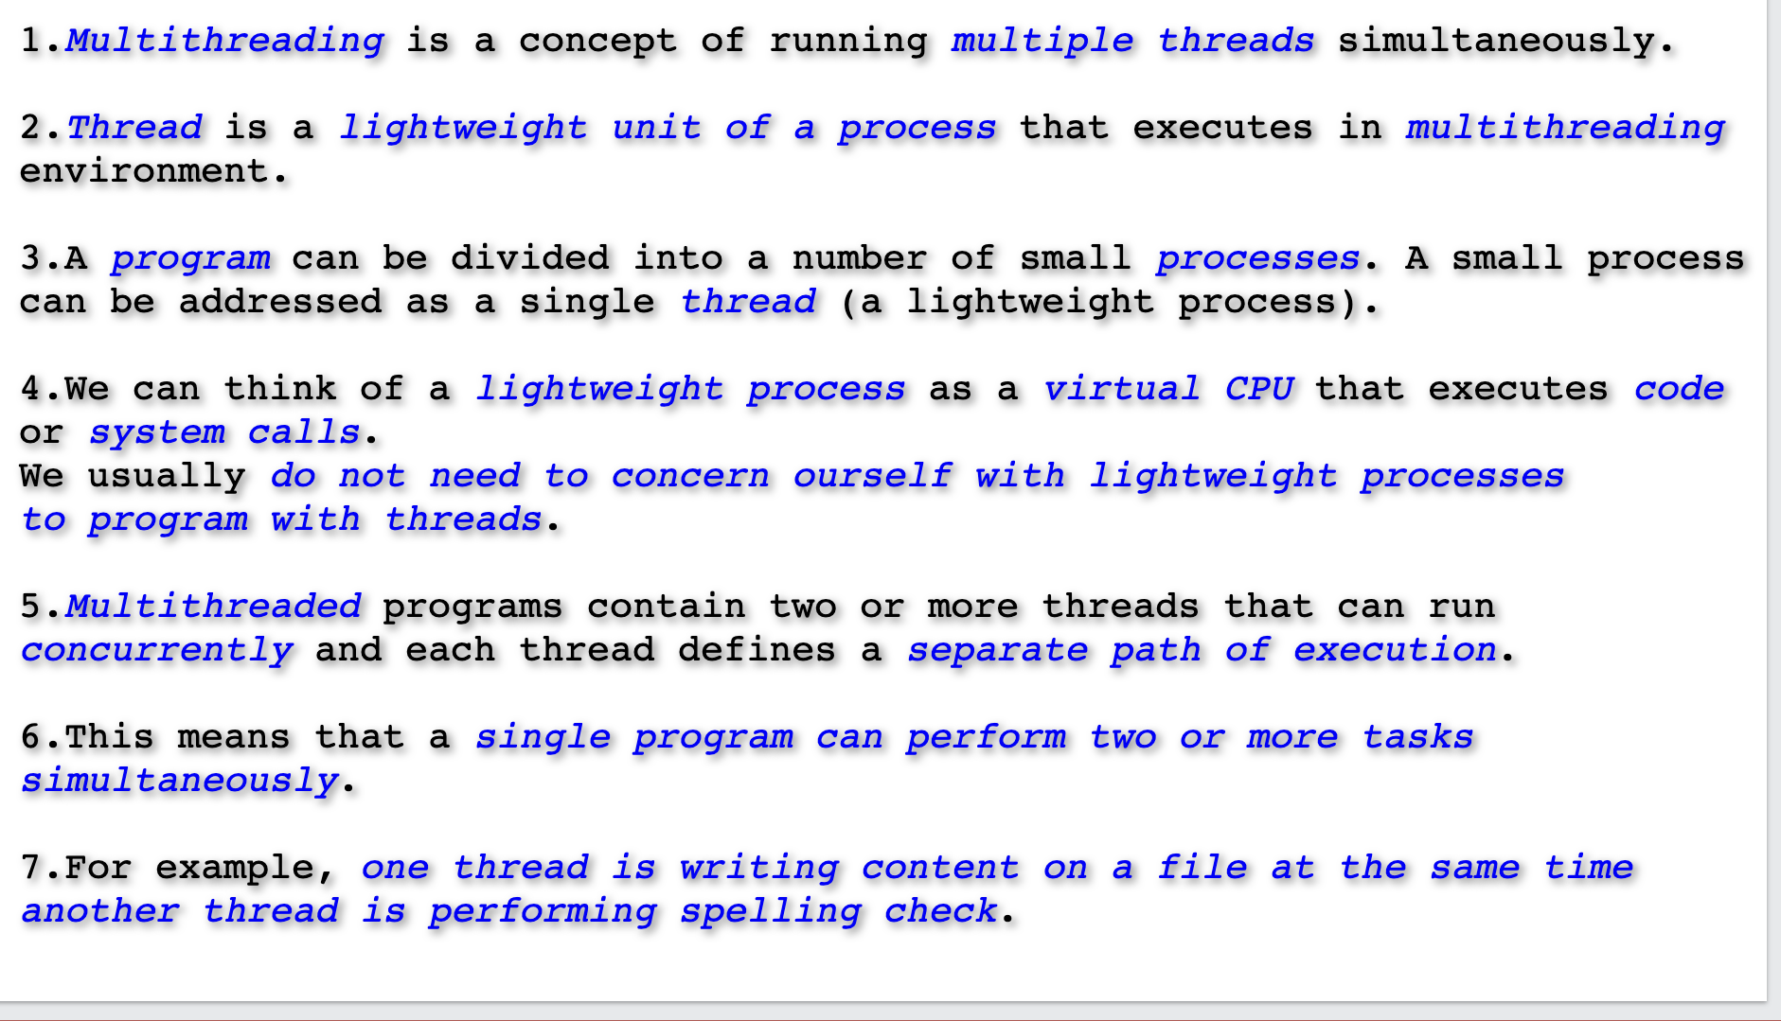
Multithreading Introduction

Slide 2
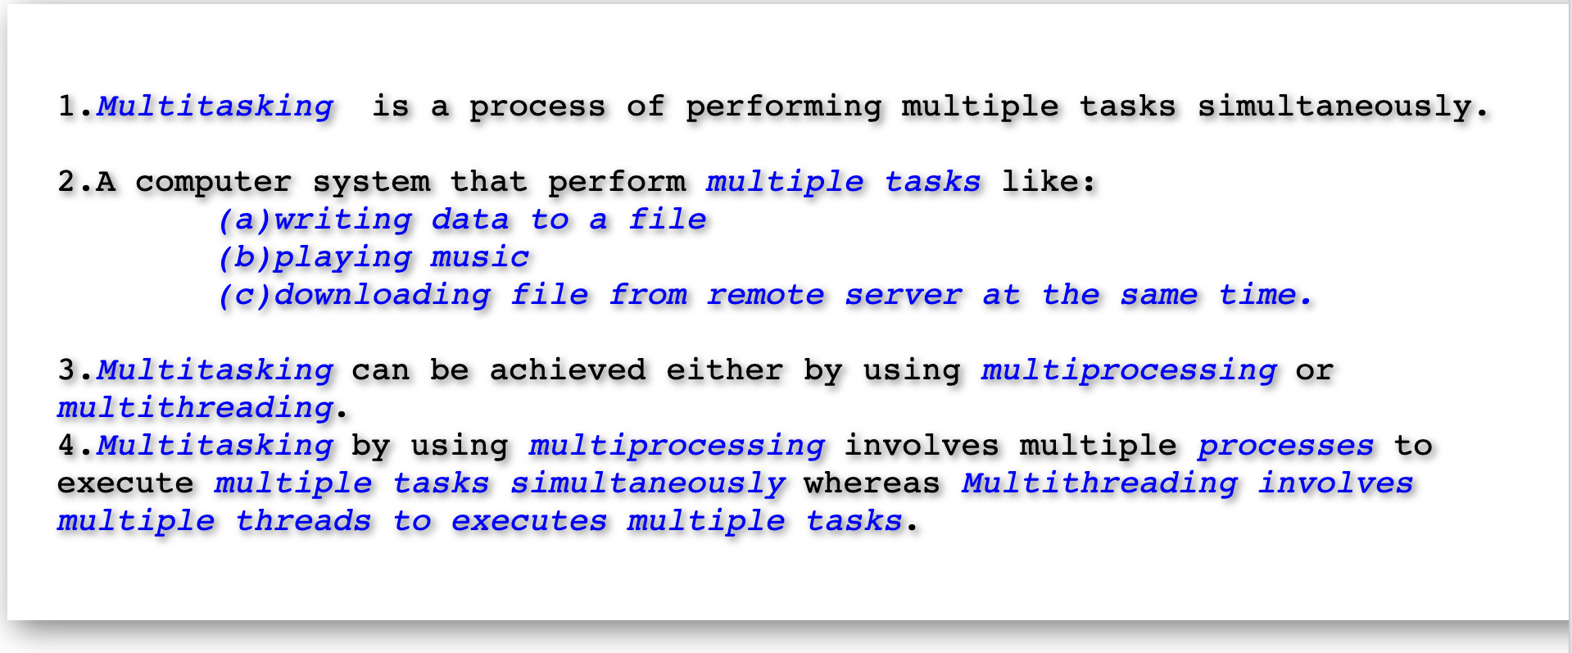
Multitasking

Slide 3
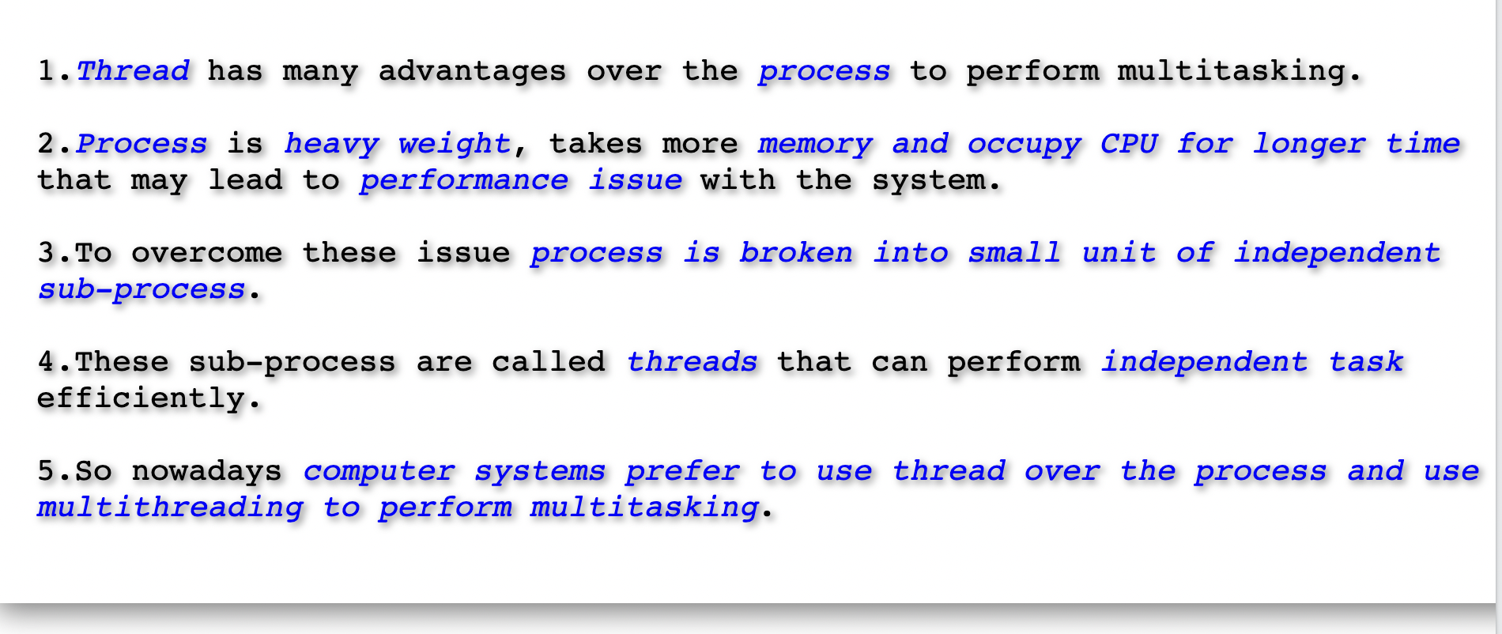
Why Threads?

Slide 4
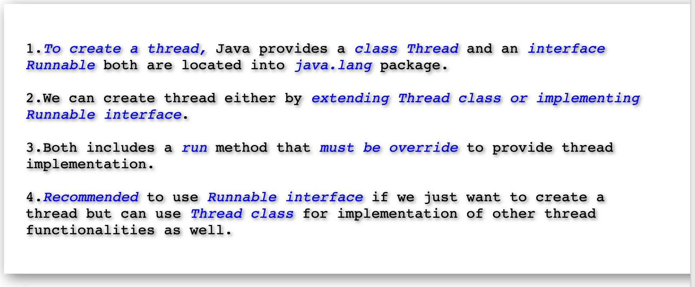
How To Create A Thread In Java?

Slide 5
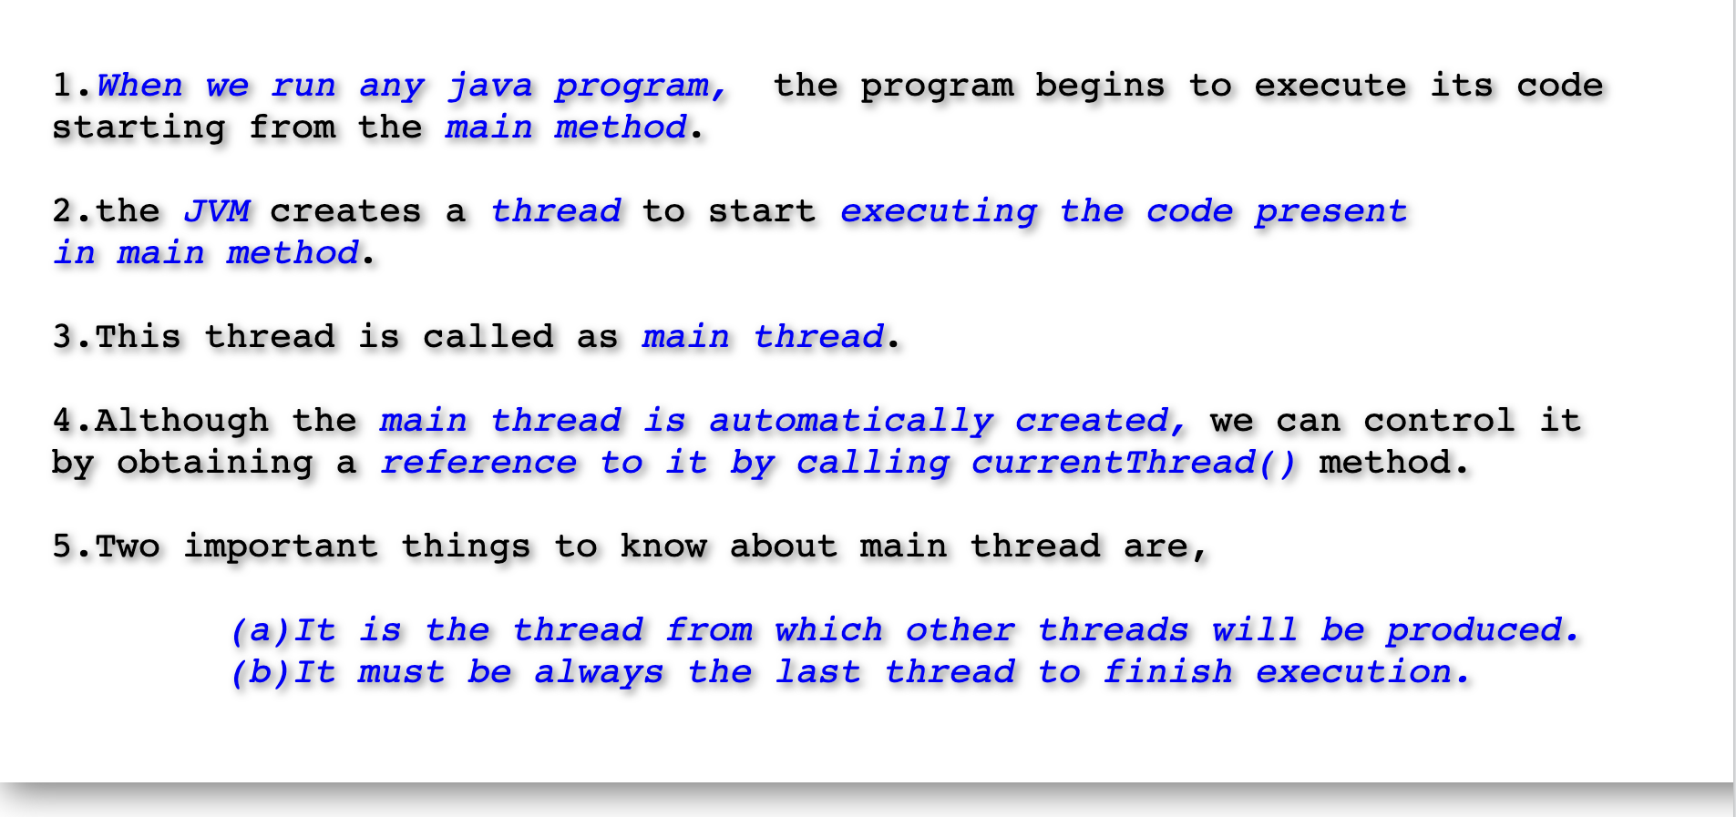
Main Thread In Java.

Slide 6
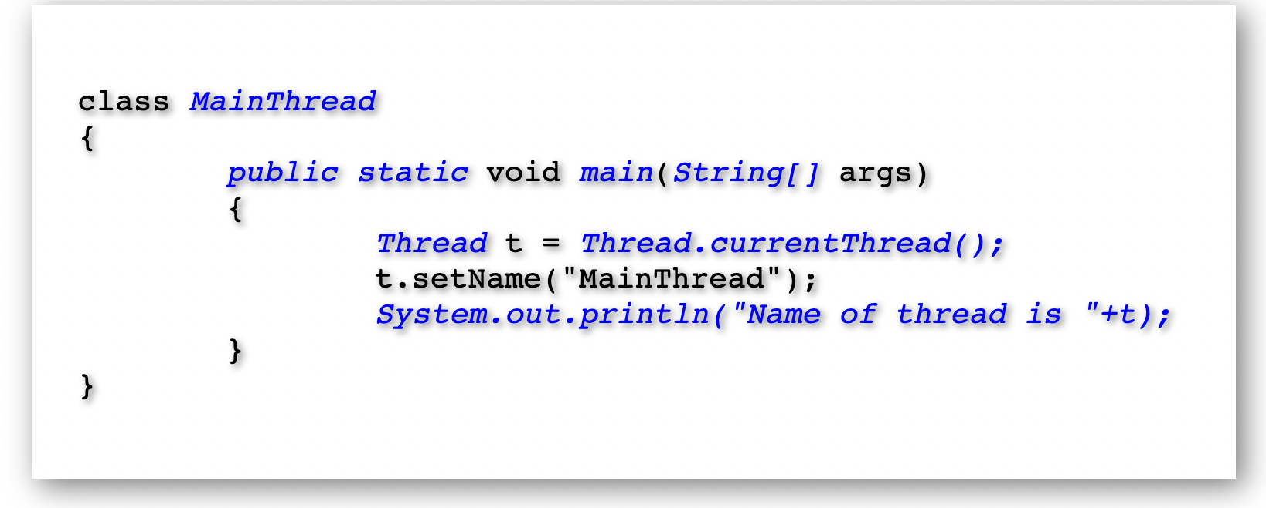
Main Thread In Java.

Slide 7
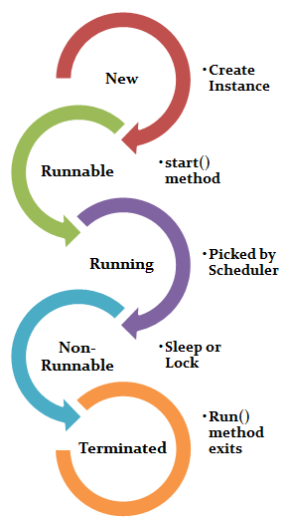
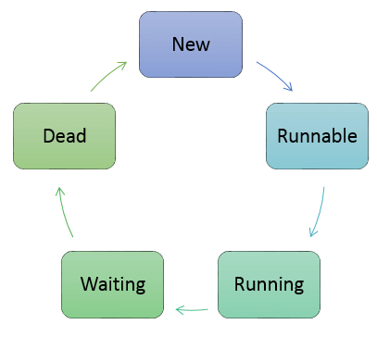
Thread Life Cycle In Java.

Slide 8
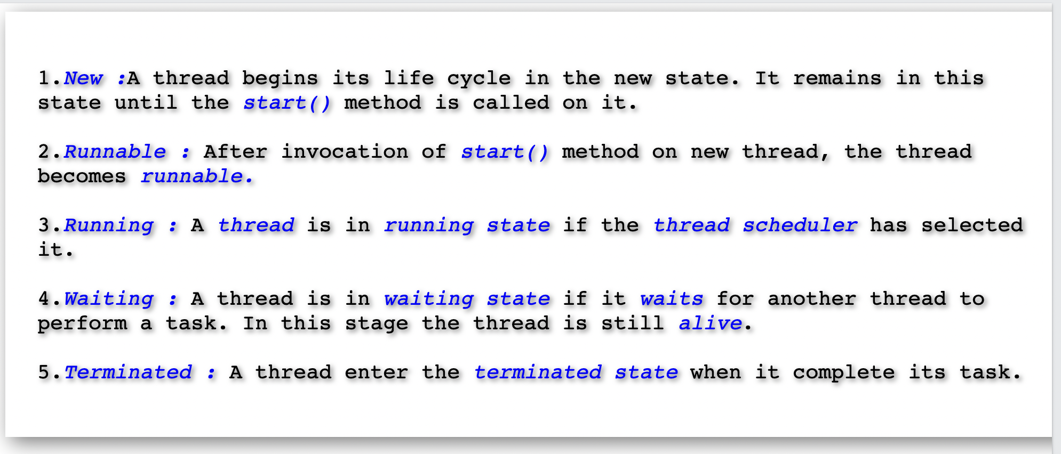
Thread Life Cycle.

Slide 9
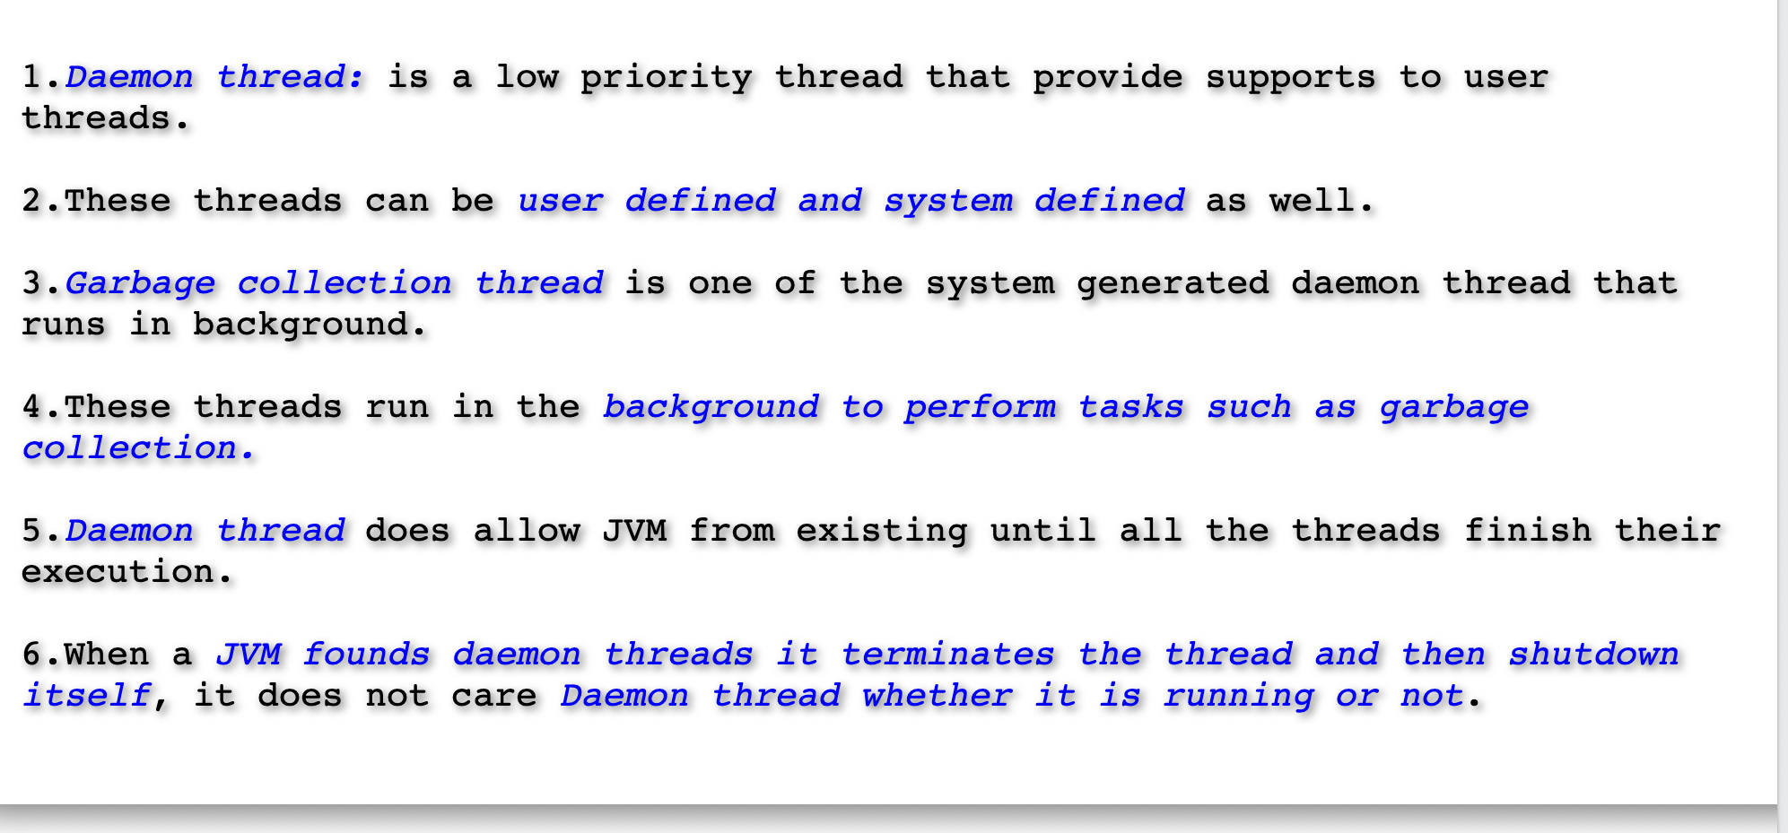
Daemon Thread

Slide 10
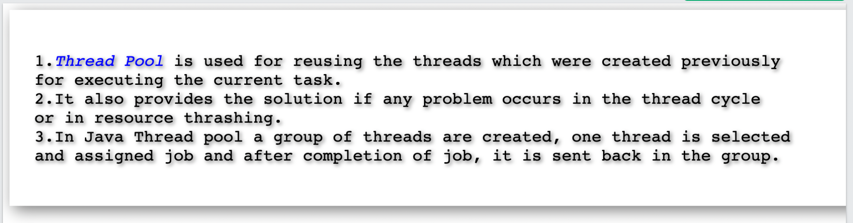
Thread Pool

Slide 11
Thread Pool

Slide 12
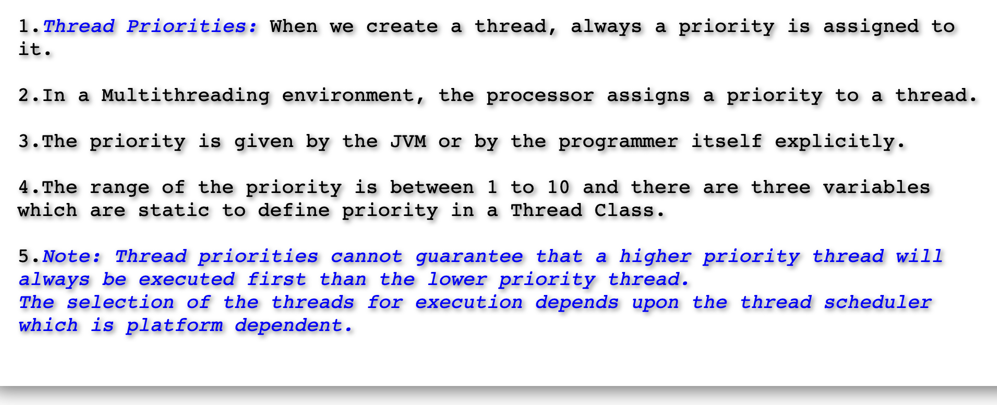
Thread Priorities

Slide 13
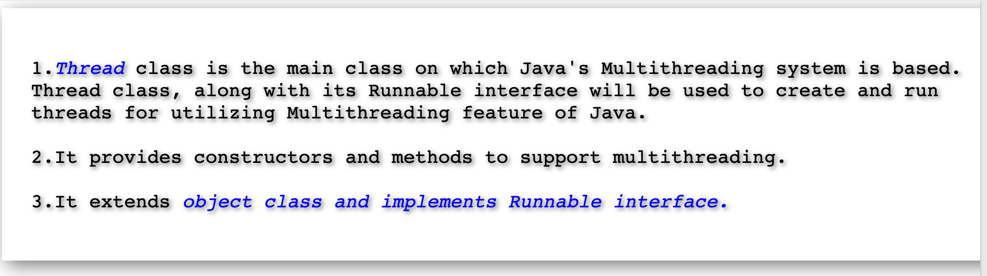
java.lang.Thread class

Slide 14
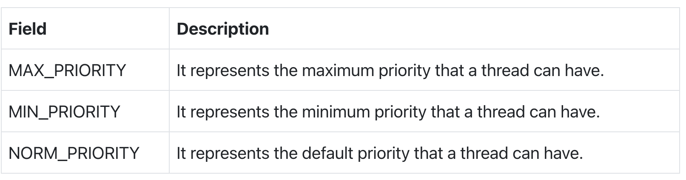
Thread Priority

Slide 15
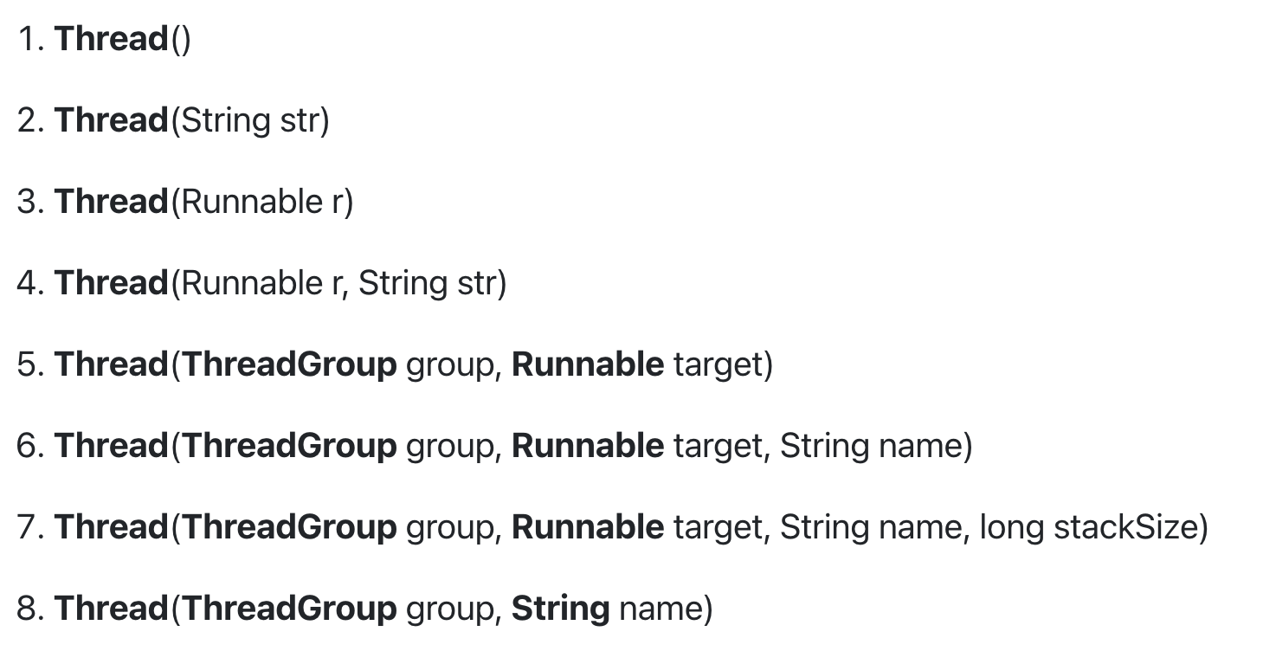
Thread Constructors

Slide 16
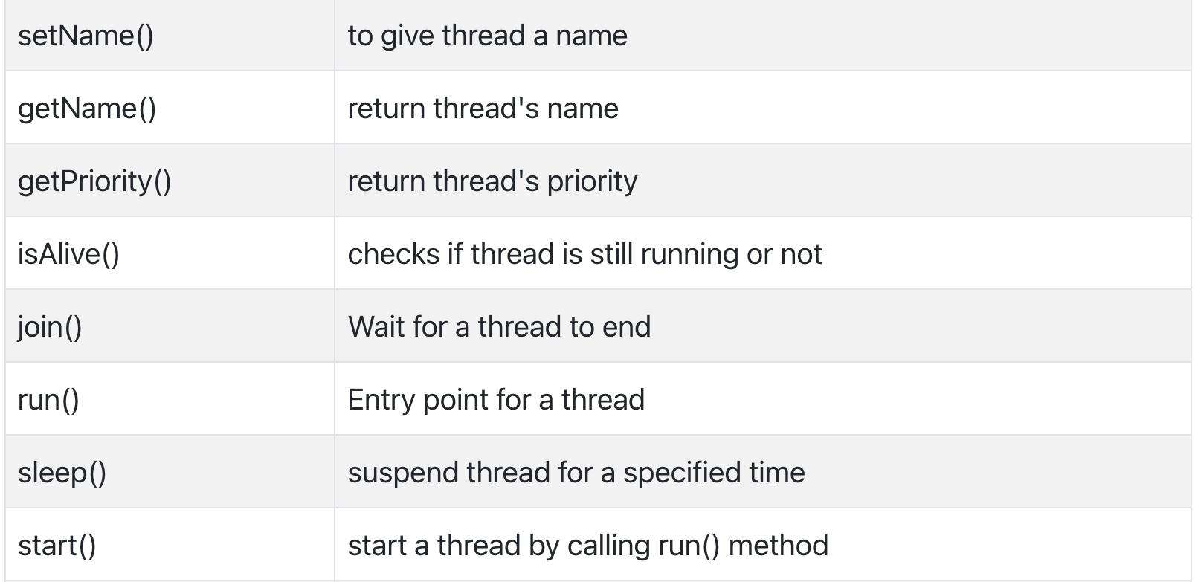
Thread Class Methods

Slide 17
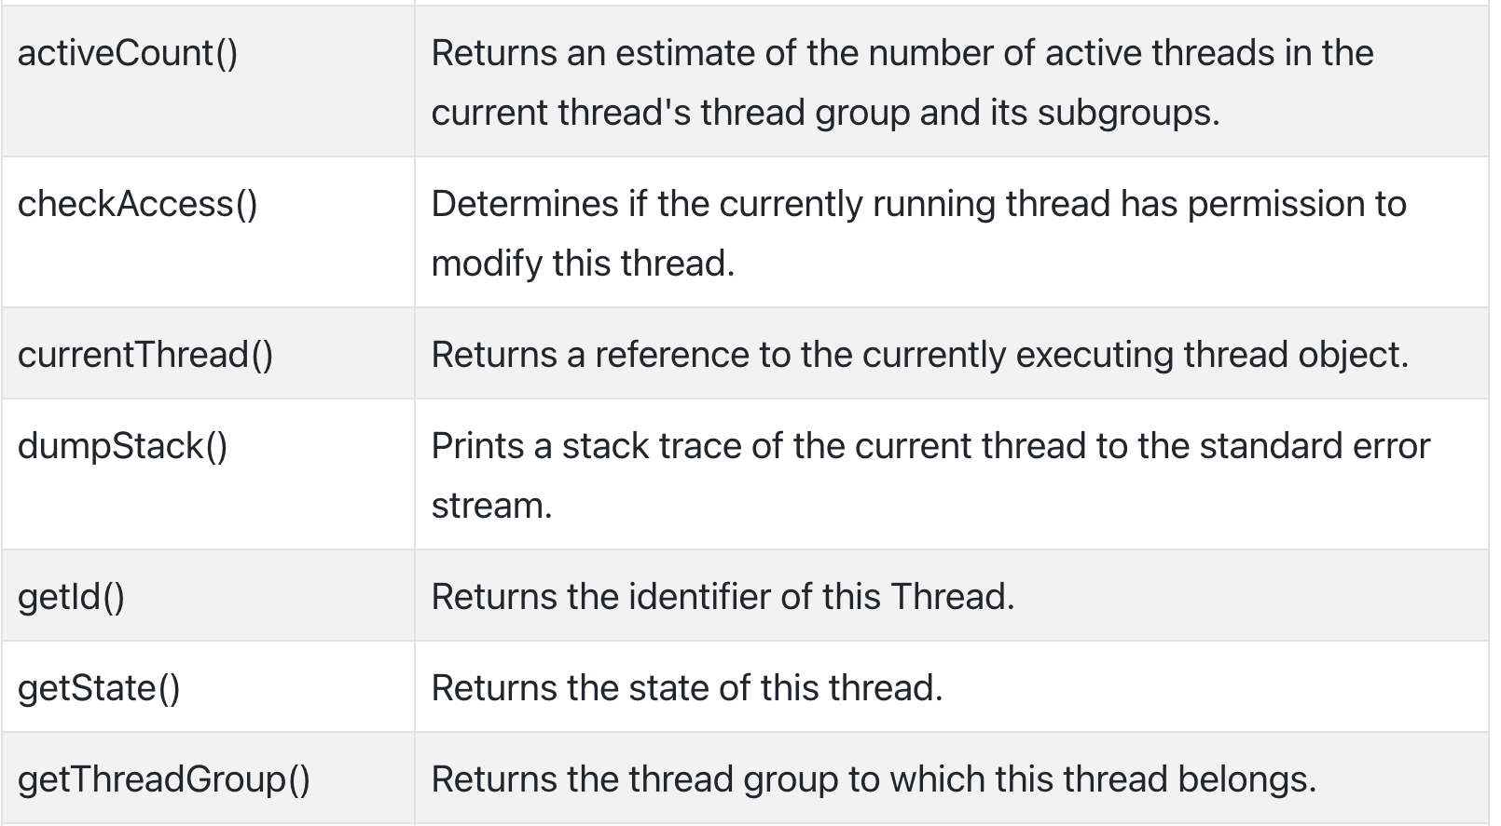
Thread Class Methods

Slide 18
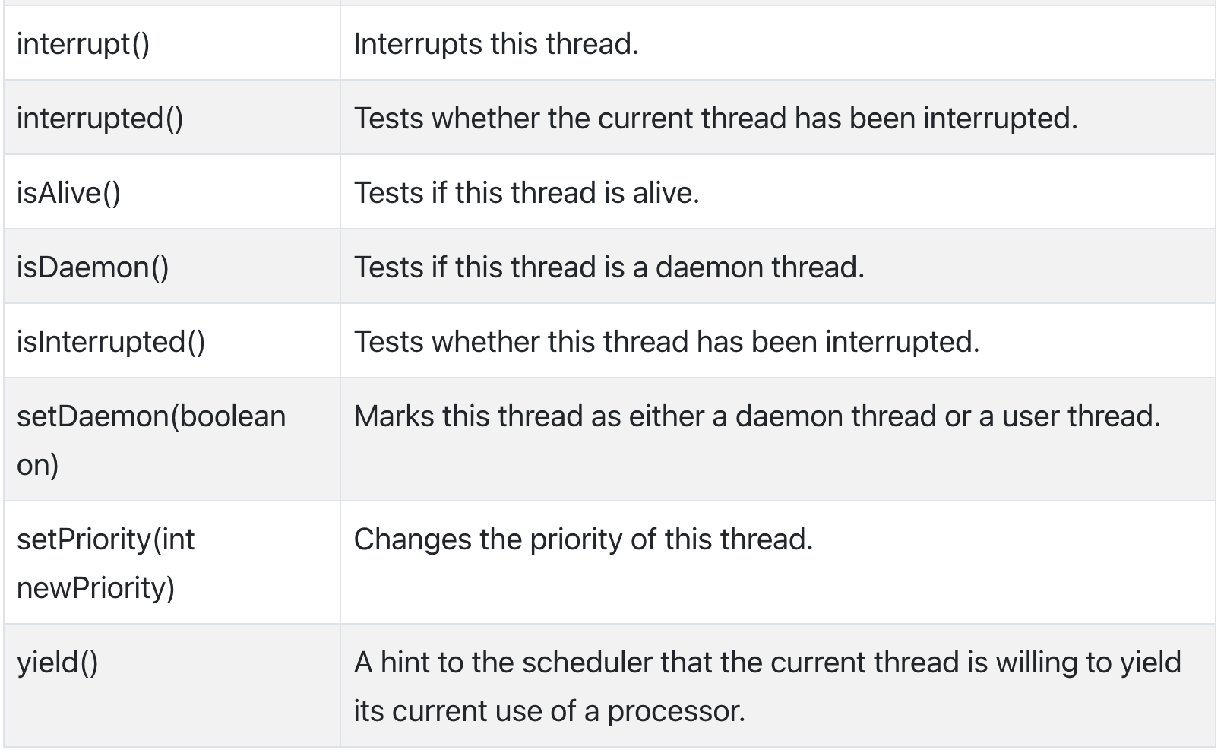
Thread Class Methods

Slide 19
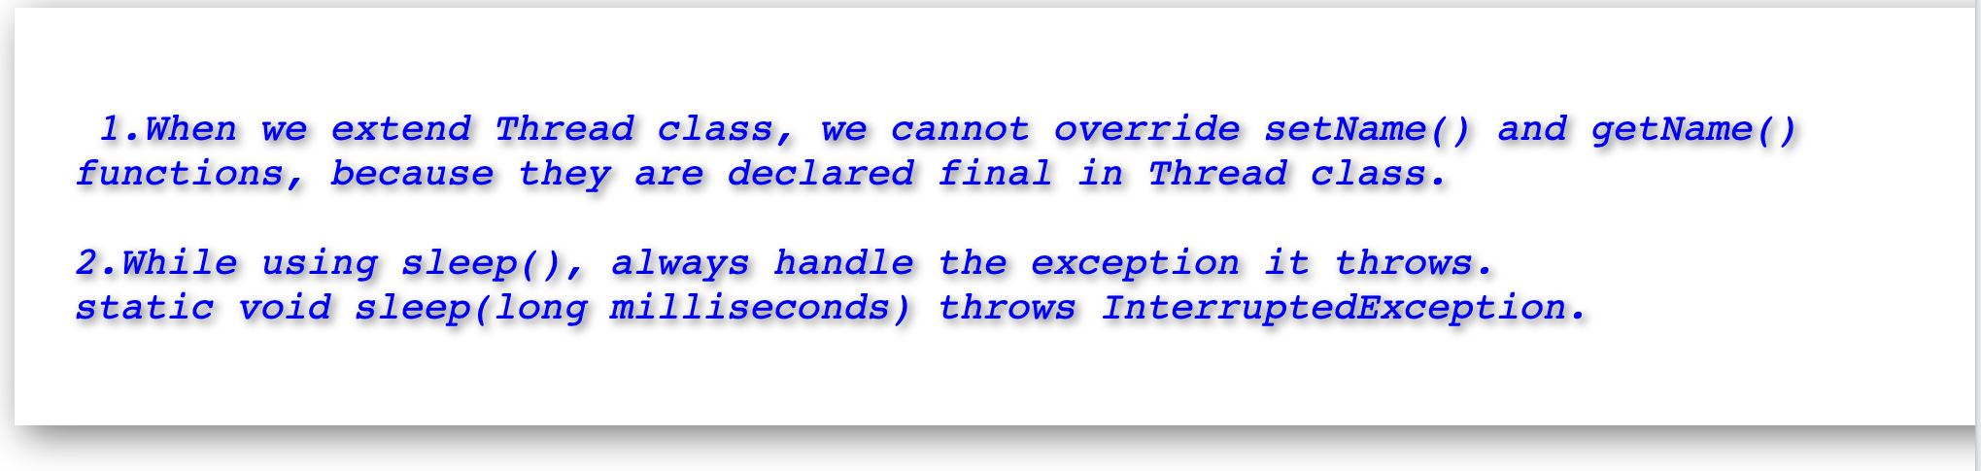
Notes.

Slide 20
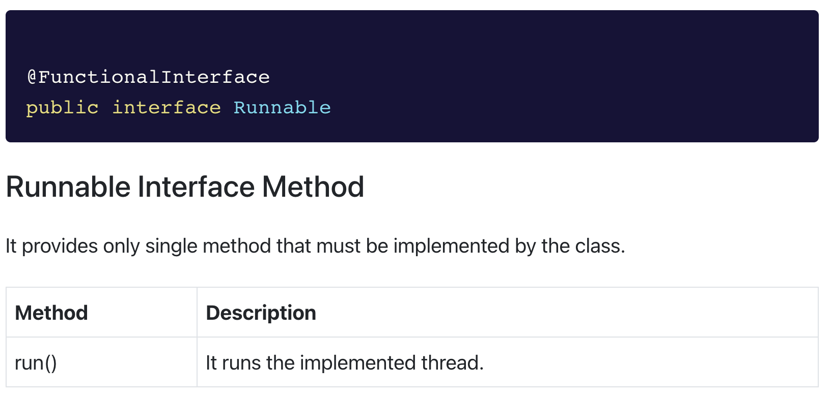
java.lang.Runnable

Slide 21
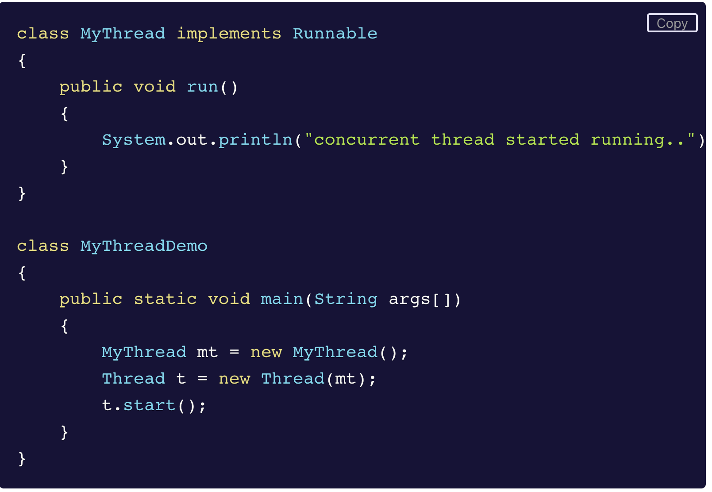
Create A Thread using Runnable Interface

Slide 22
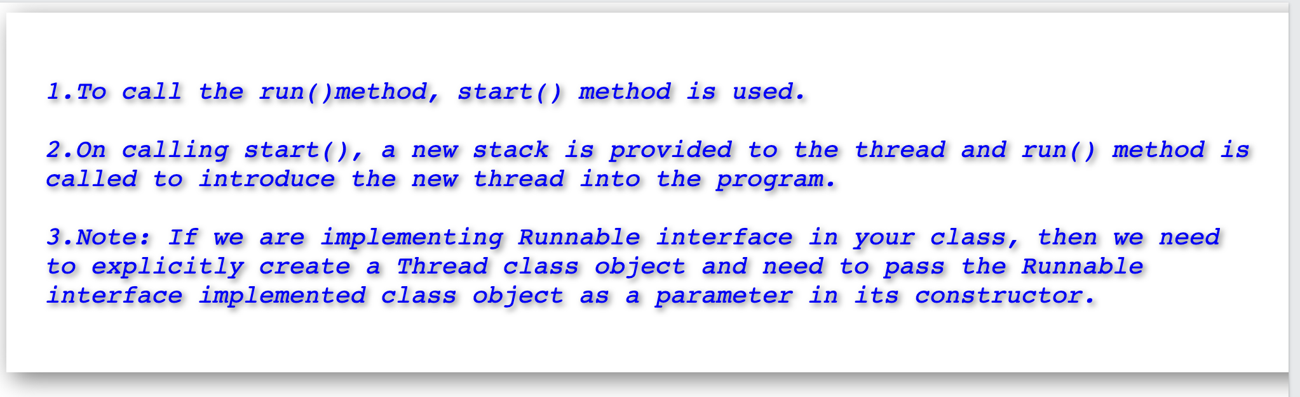
Create A Thread using Runnable Interface

Slide 23
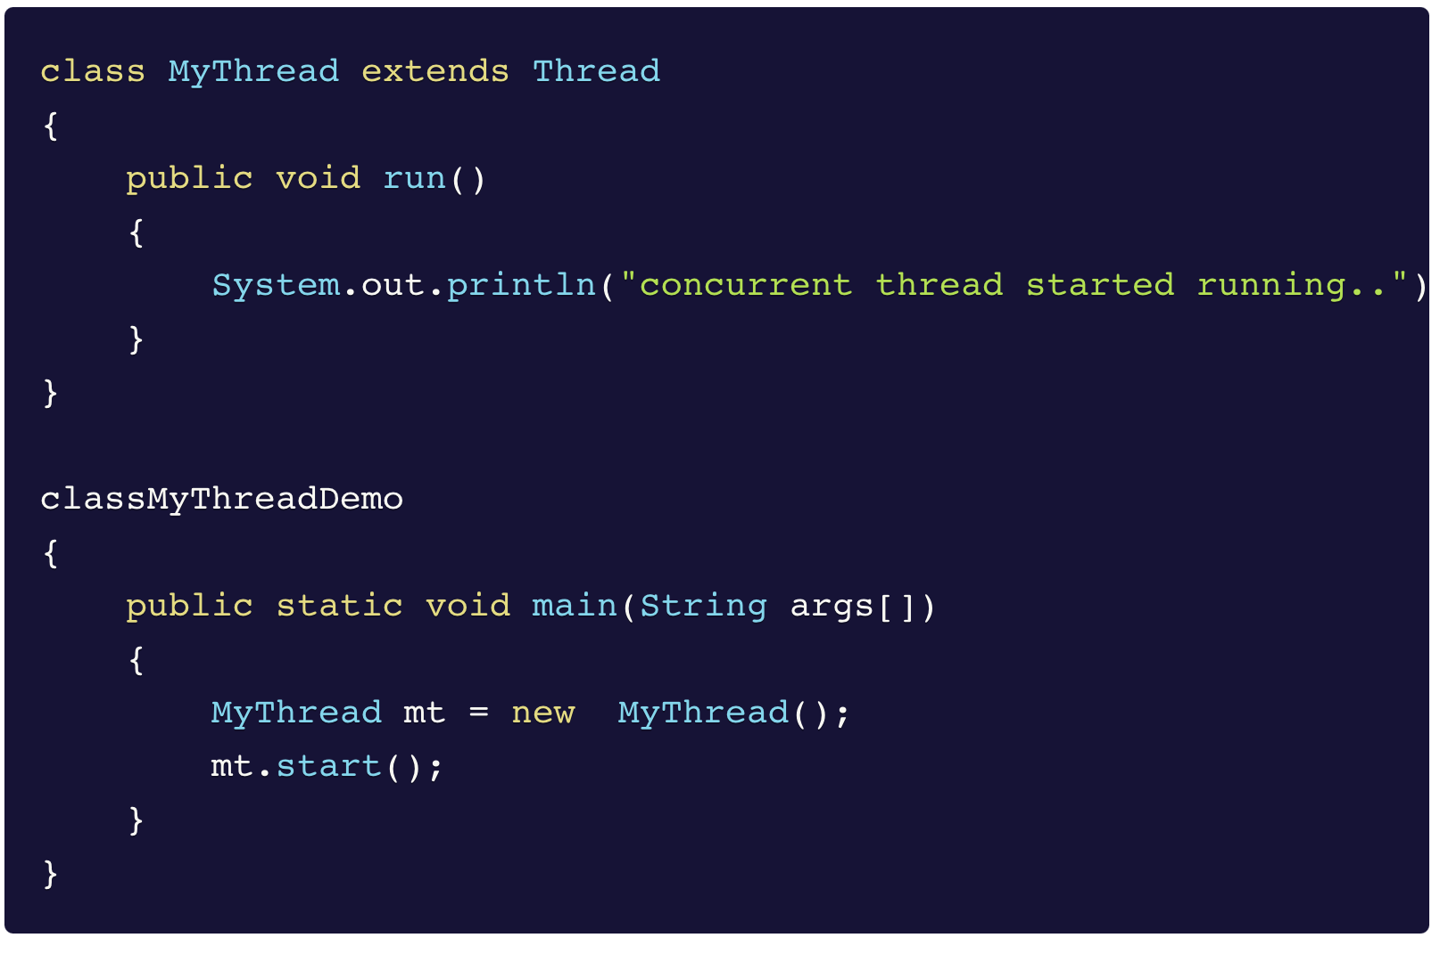
Create A Thread Extending Thread Class

Slide 24
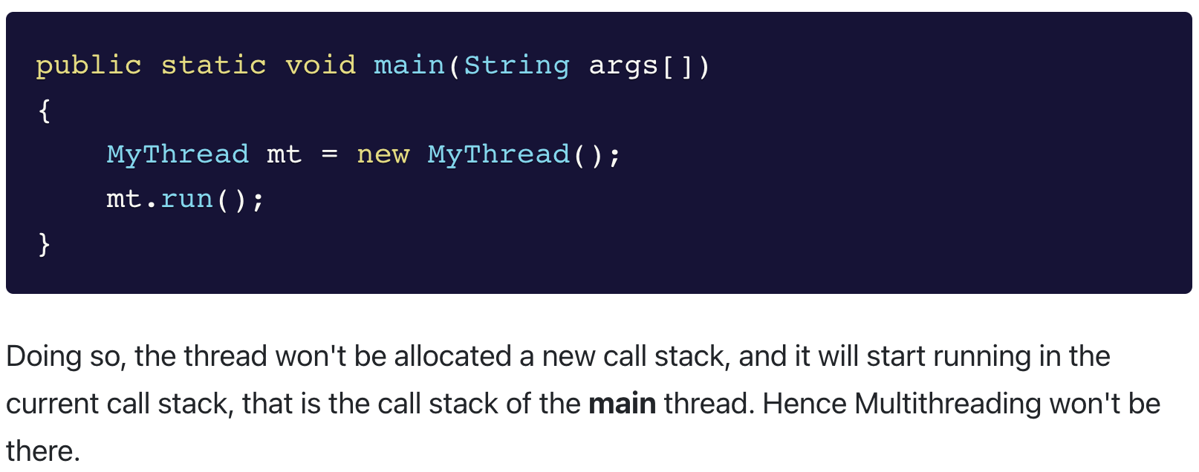
Directly Executing Run()

Slide 25
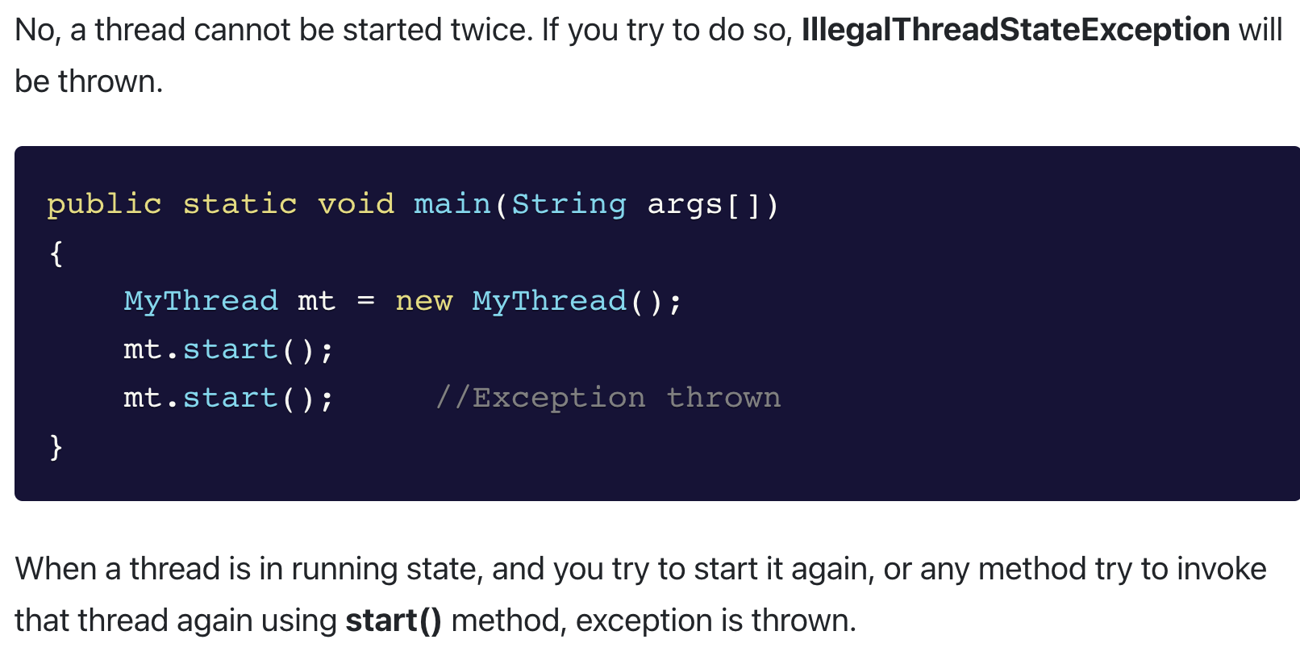
Can A Thread Started Twice?

Slide 26
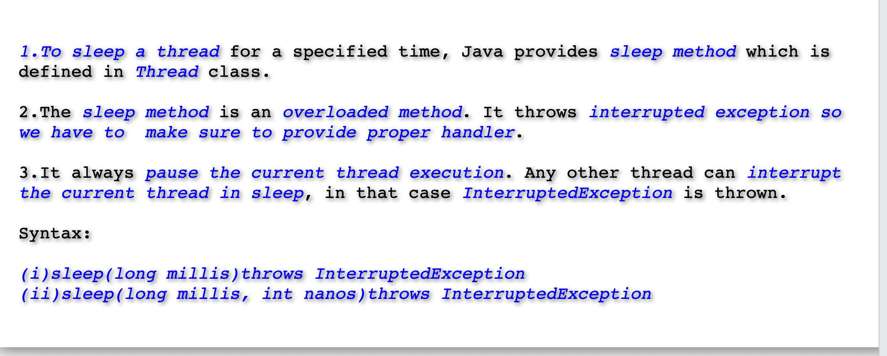
Thread.sleep()

Slide 27
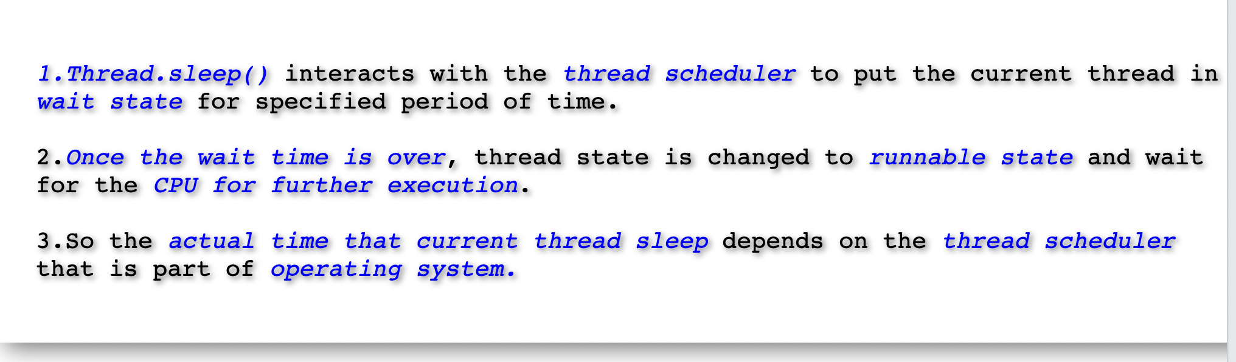
Thread.sleep()

Slide 28
Thread.sleep()

Slide 29
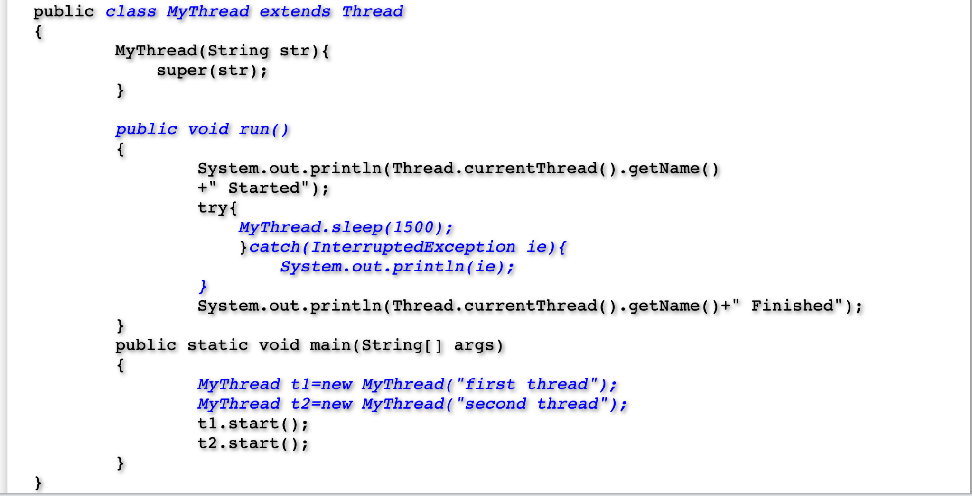
Example On Thread.sleep()

Slide 30
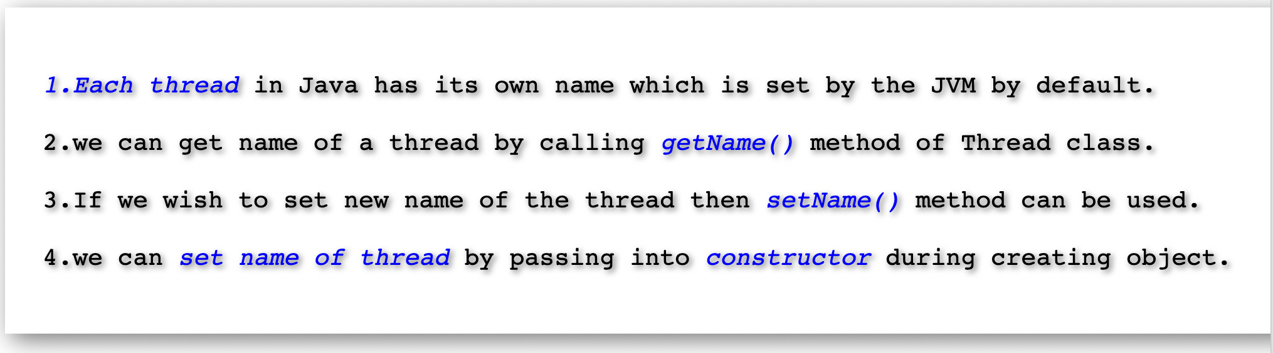
Naming A Thread

Slide 31
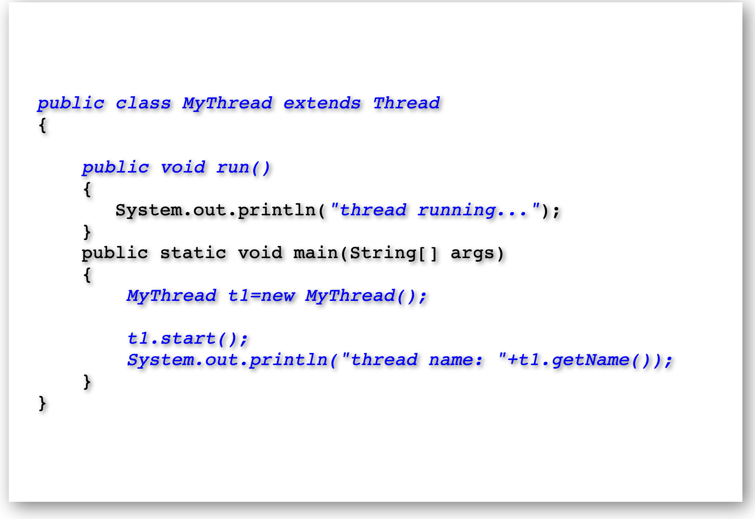
Naming A Thread

Slide 32
Naming A Thread

Slide 33
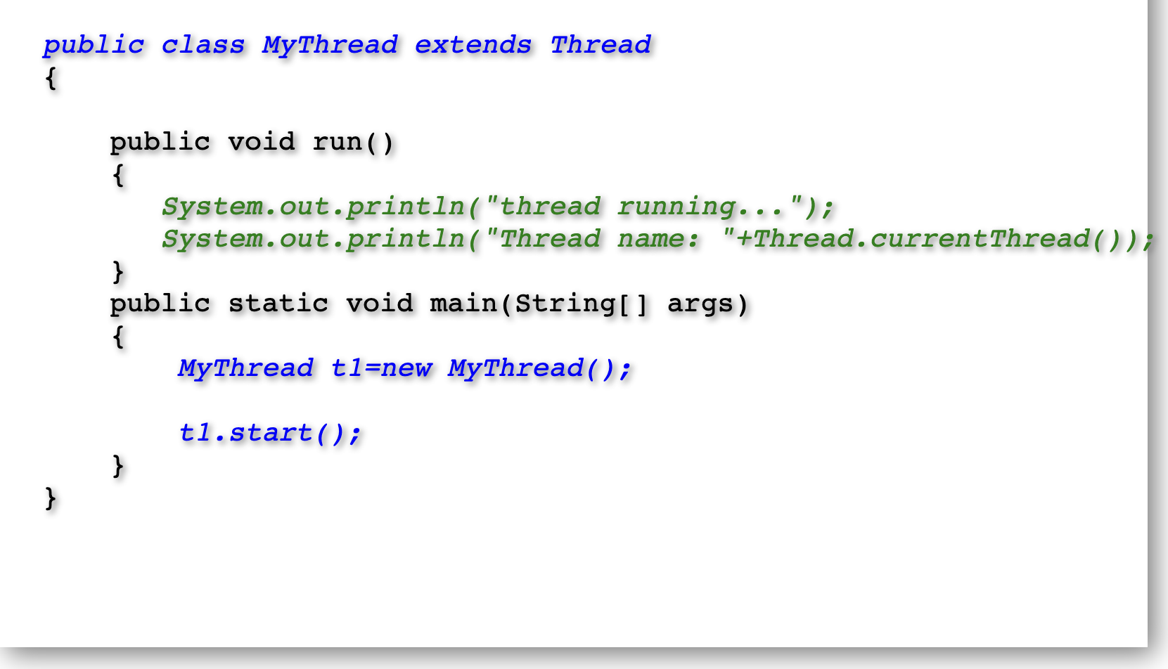
Getting A Reference to Current Thread

Slide 34
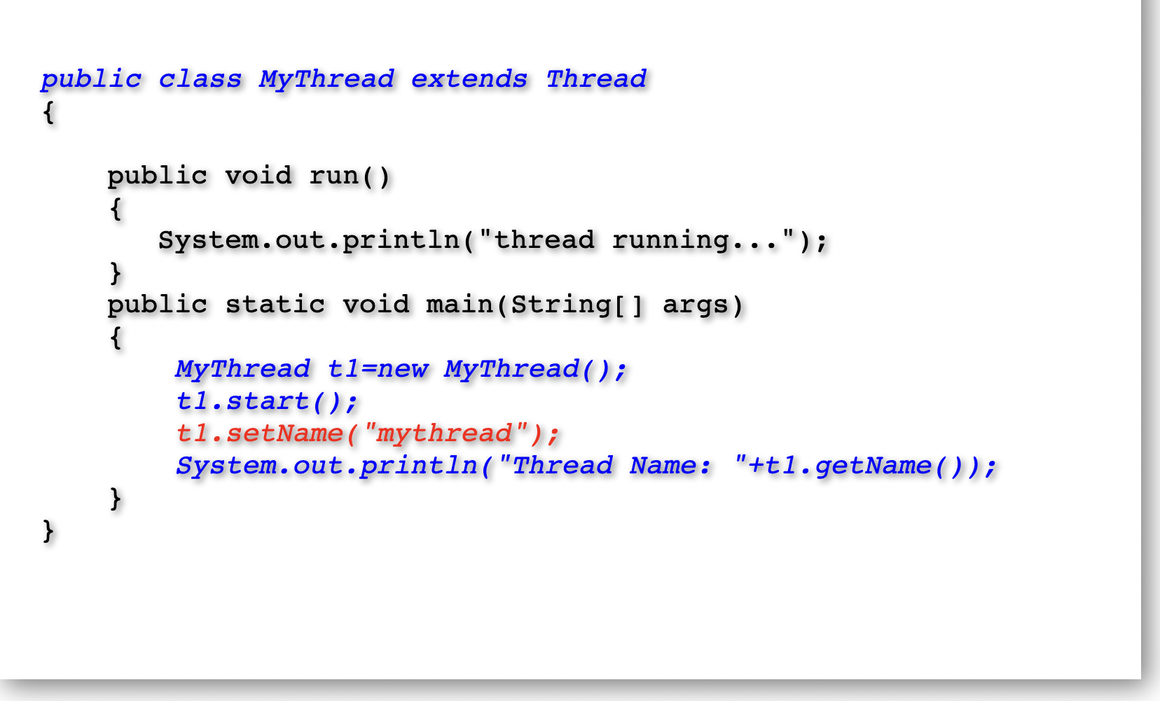
Setting The Name Of Thread

Slide 35
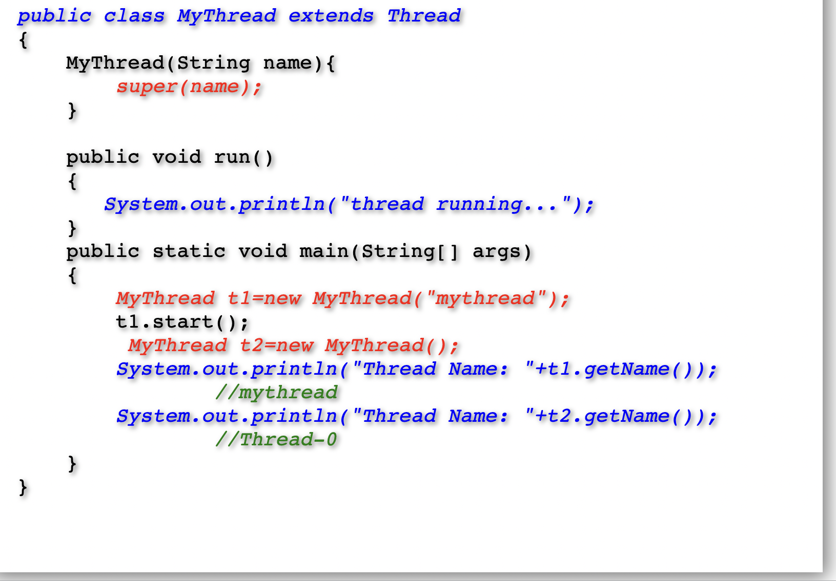
Setting The Name Of Thread Using Constructor

Slide 36
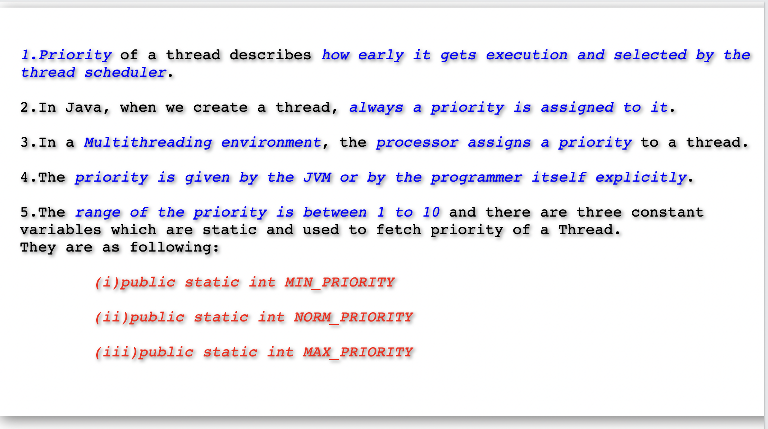
Priority Of A Thread

Slide 37
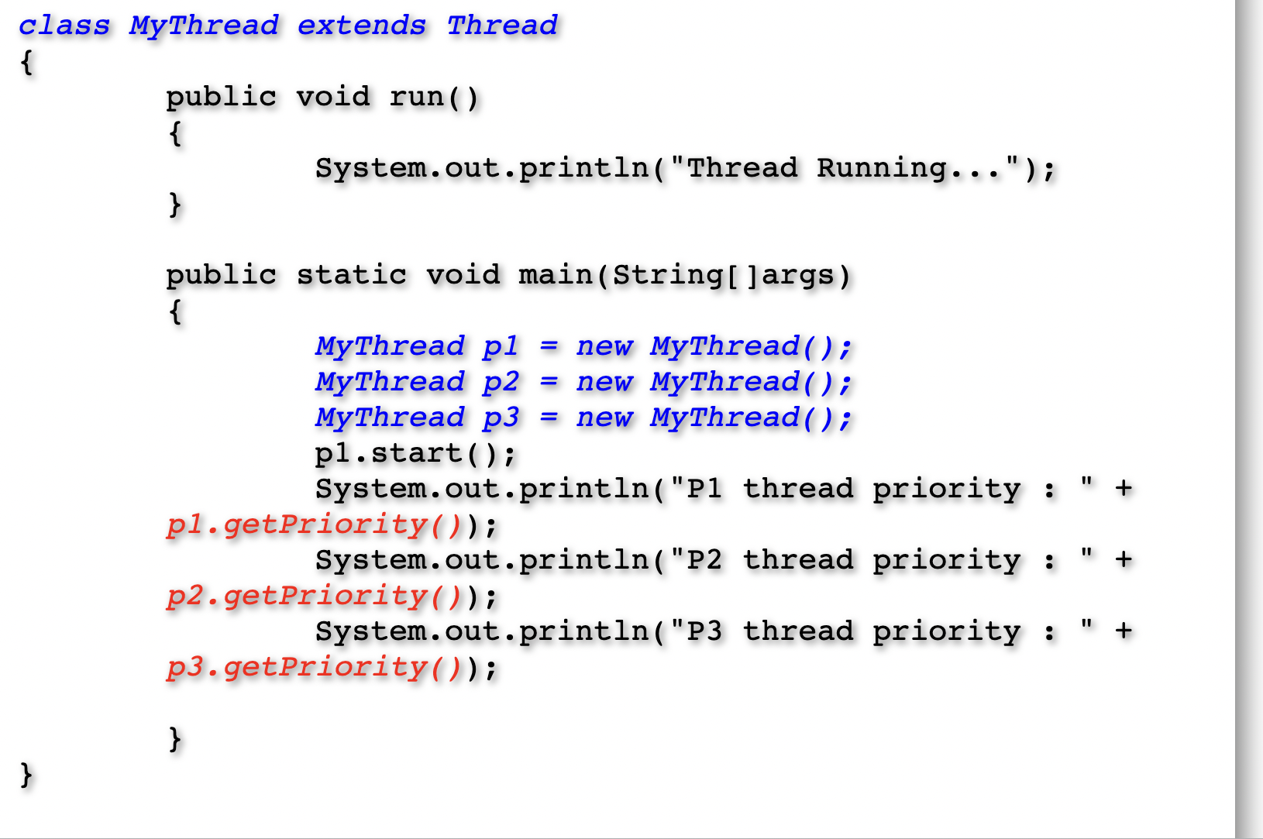
Getting Priority Of A Thread

Slide 38
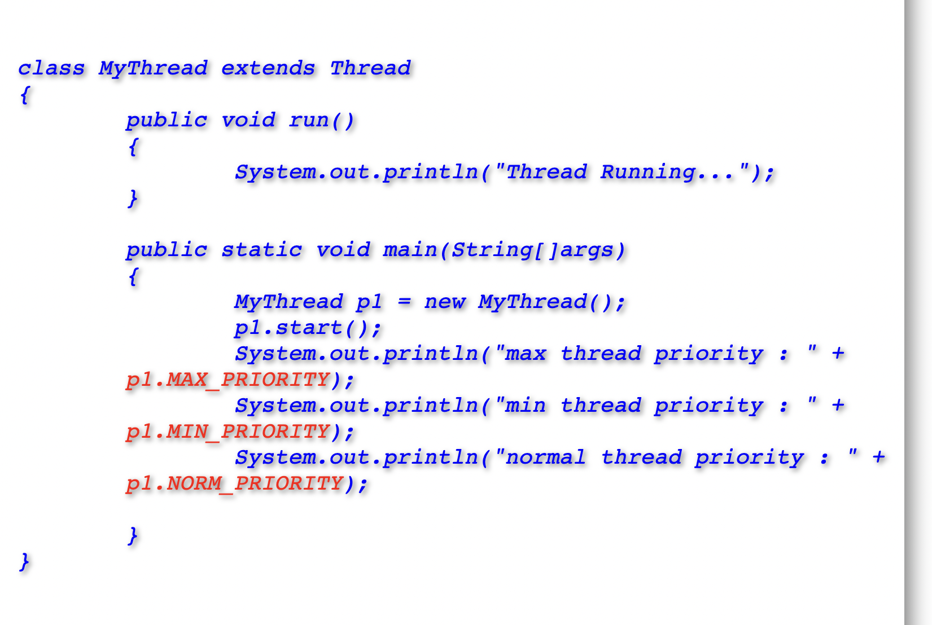
Constant For Thread Priority

Slide 39
Constant For Thread Priority

Slide 40
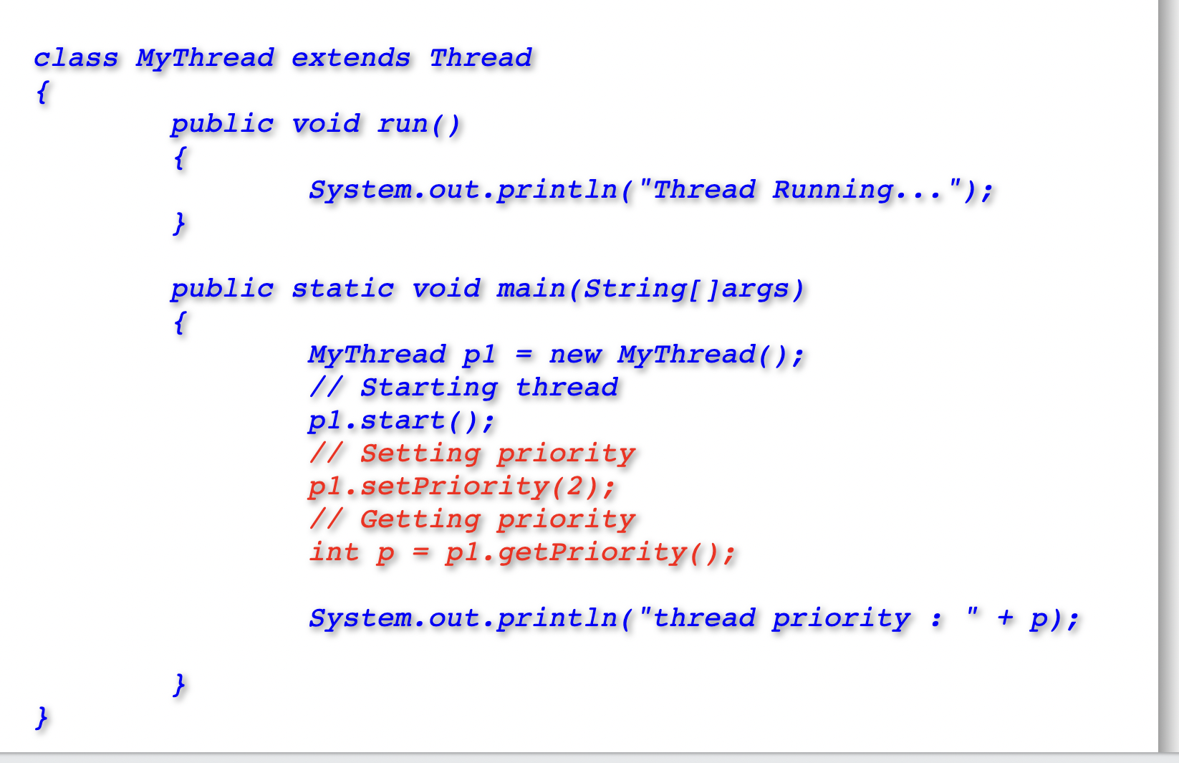
Setting A Thread Priority

Slide 41
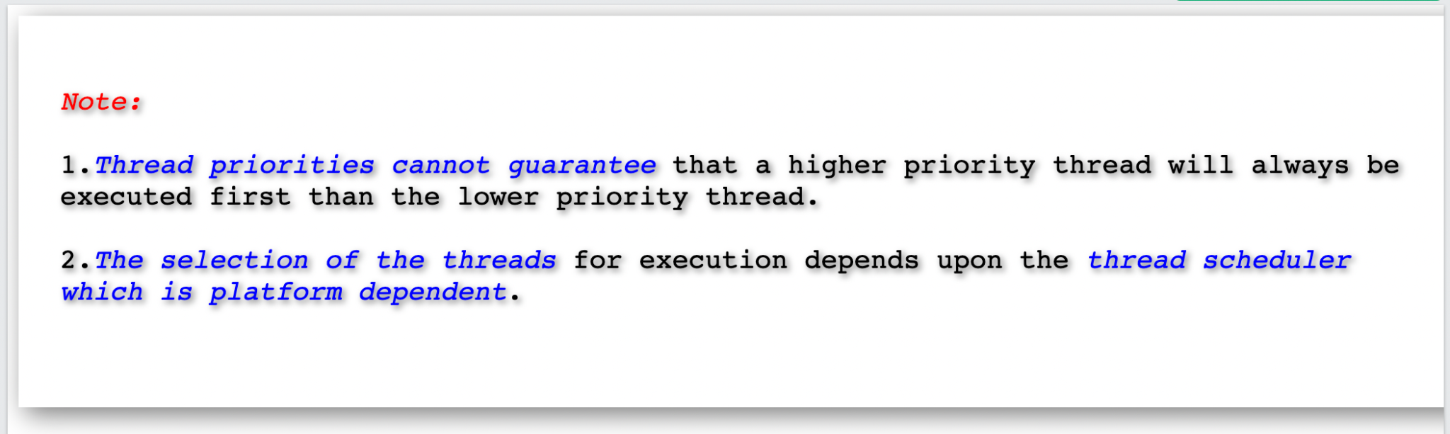
Thread Priority

Slide 42
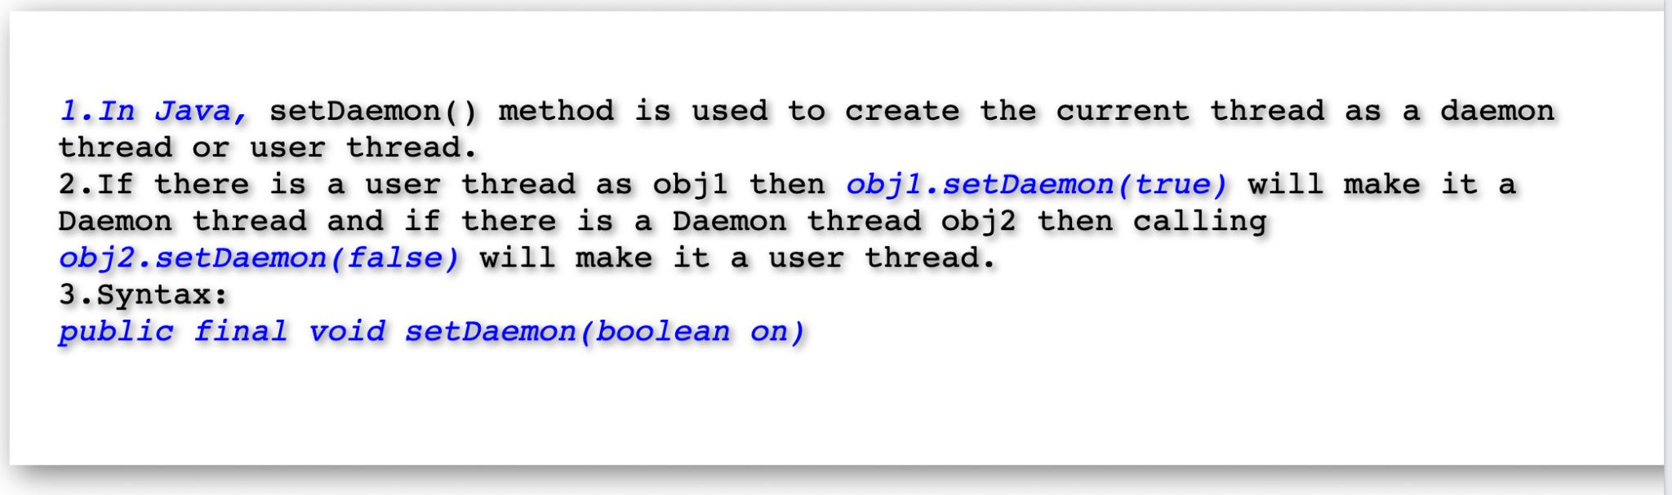
Creating Daemon Thread

Slide 43
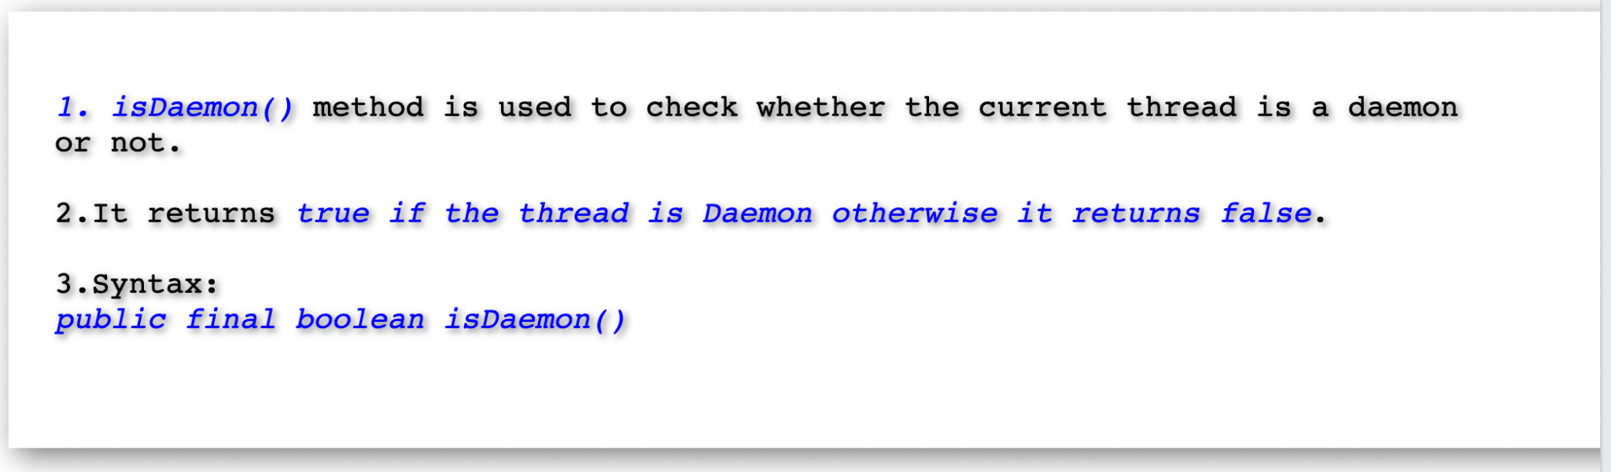
isDaemon() of Thread

Slide 44
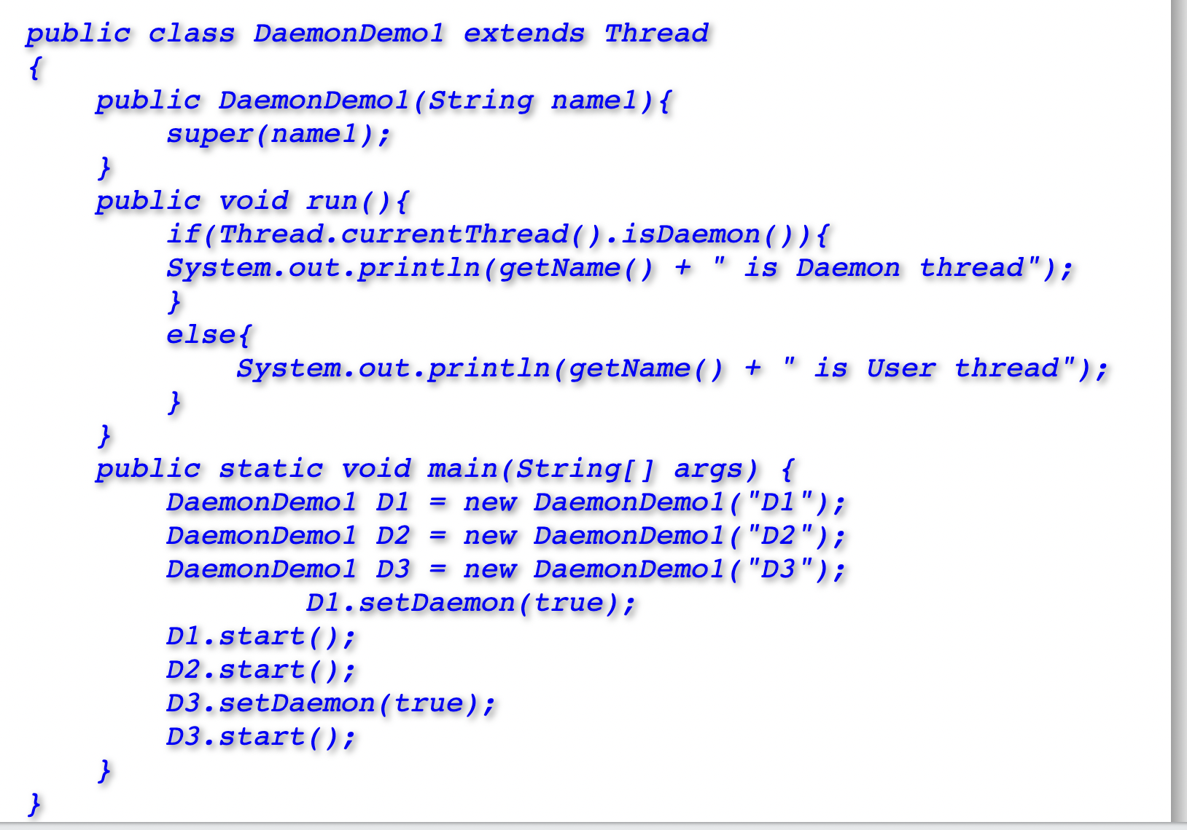
Example on isDaemon() of Thread

Slide 45
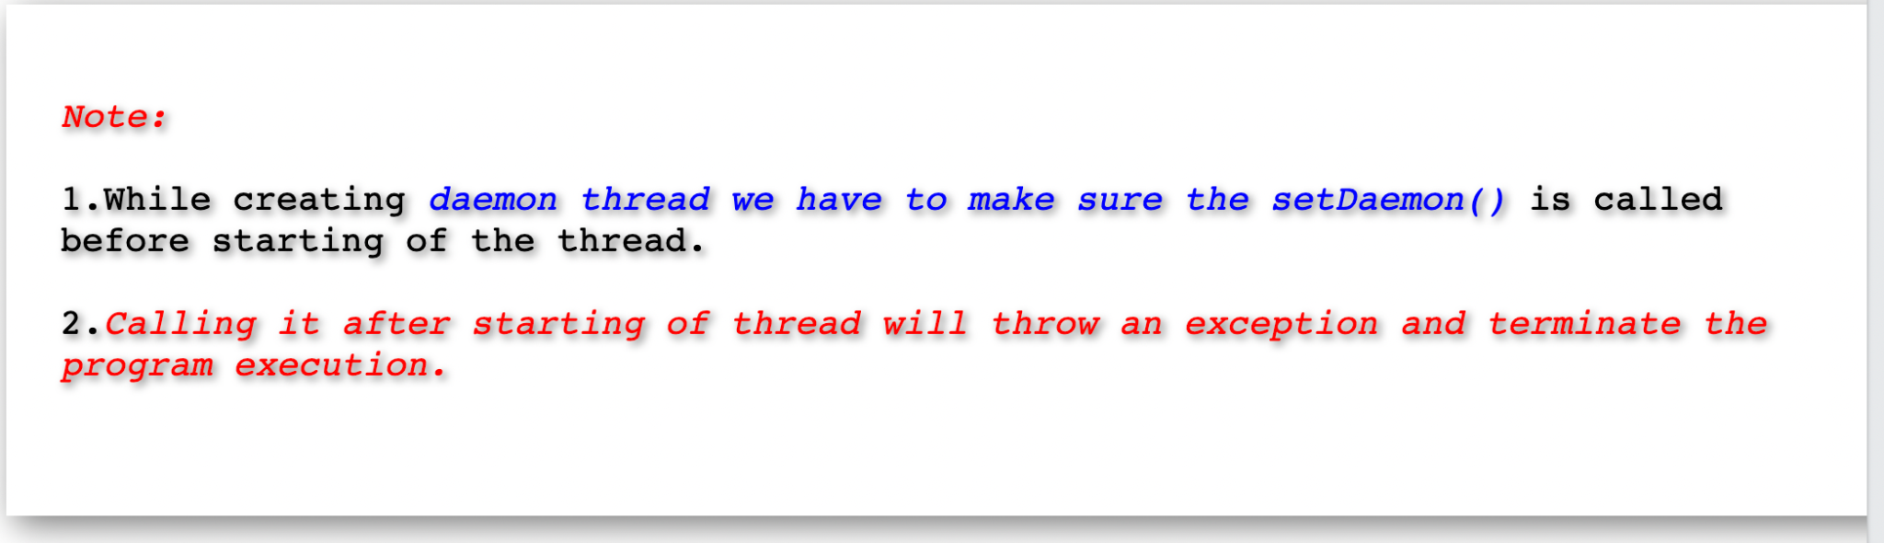
Note on setDaemon() Method

Slide 46
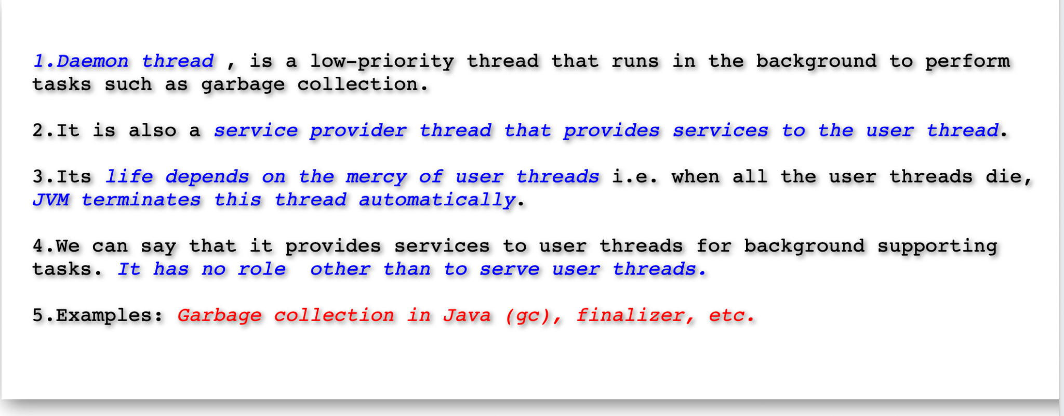
Daemon Thread

Slide 47
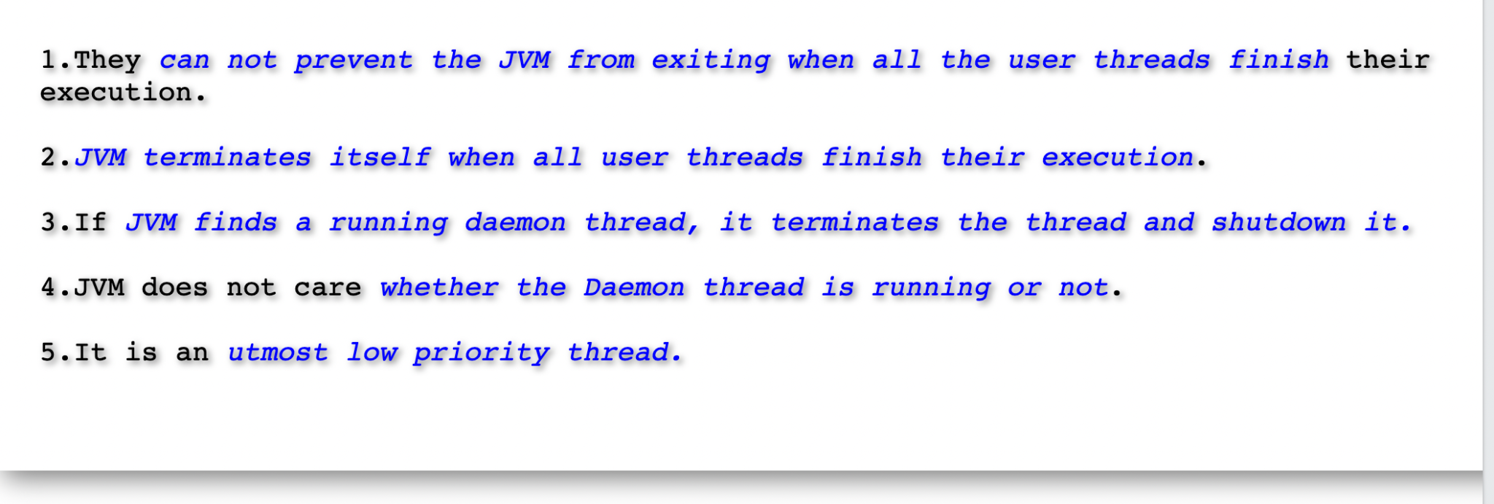
Daemon Thread

Slide 48
Daemon Thread

Slide 49
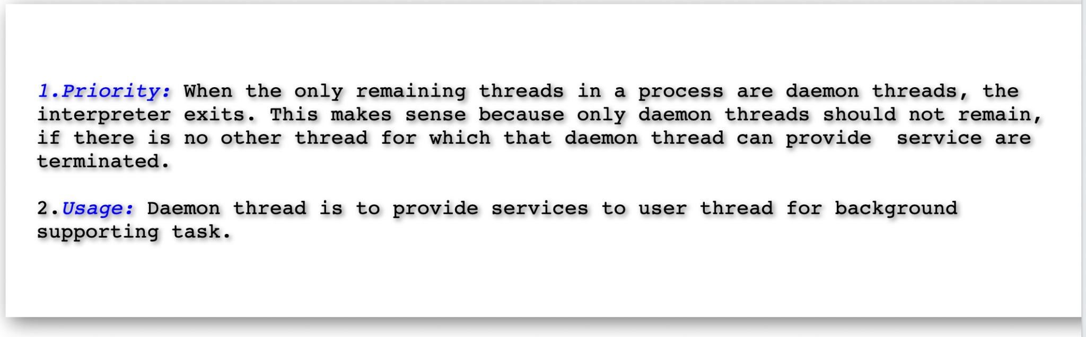
Daemon vs User Thread

Slide 50
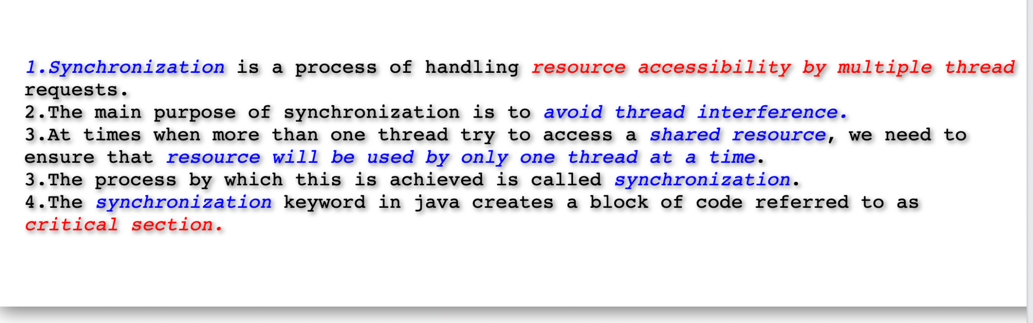
Thread Synchronization

Slide 51
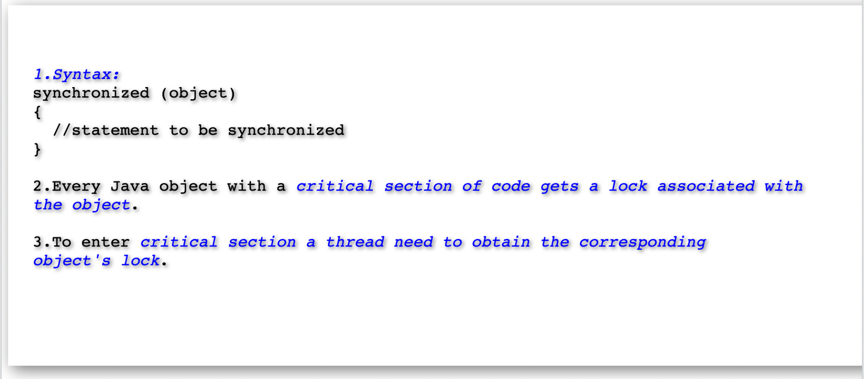
Thread Synchronization

Slide 52
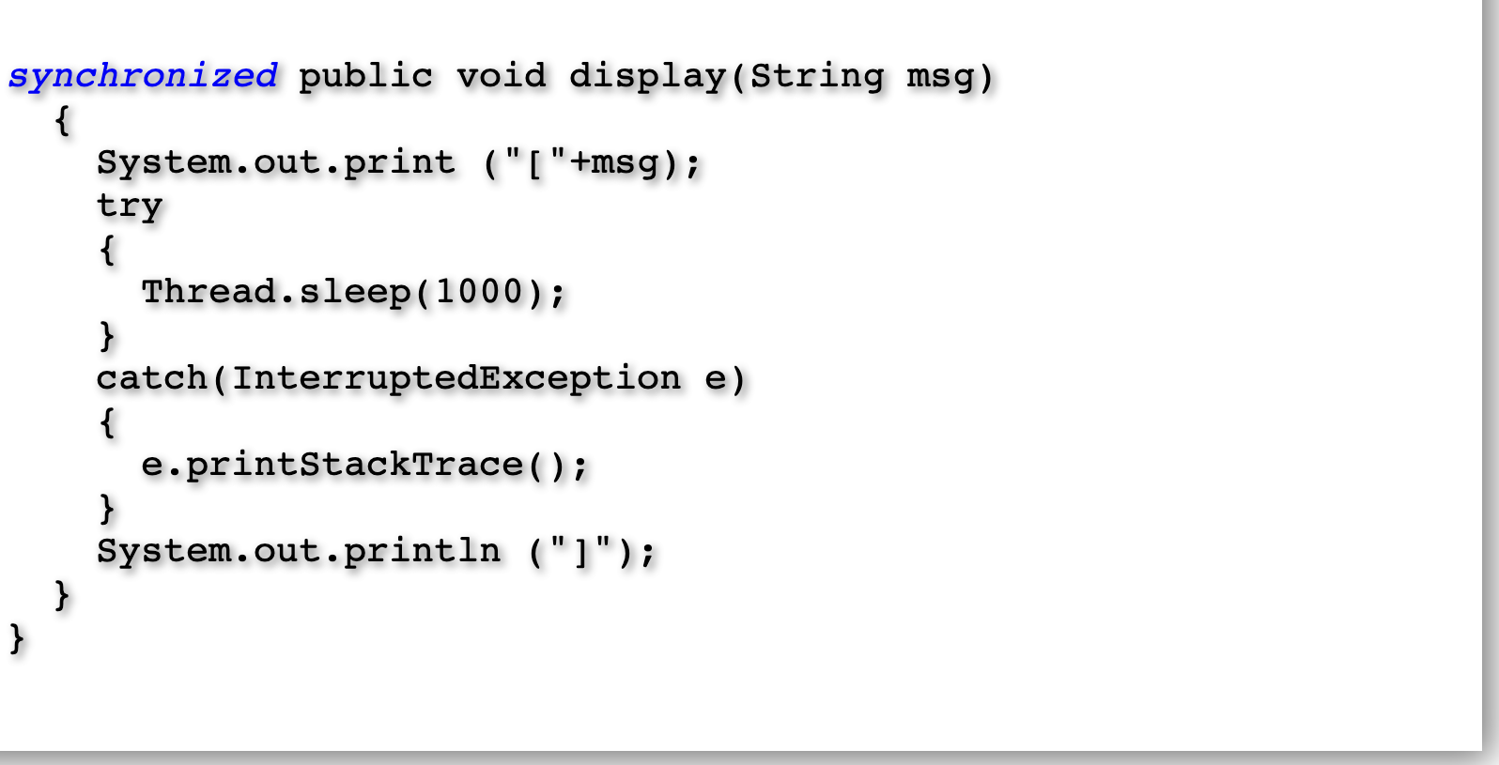
Synchronized Method

Slide 53
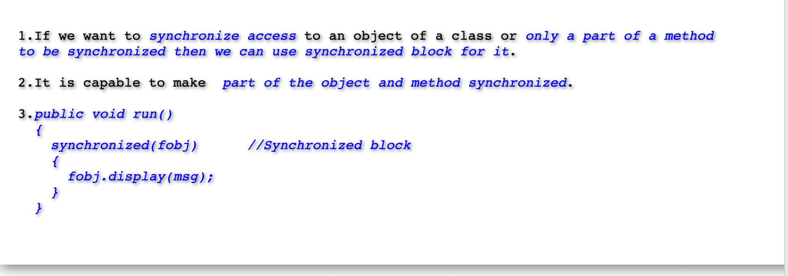
Synchronized block

Slide 54
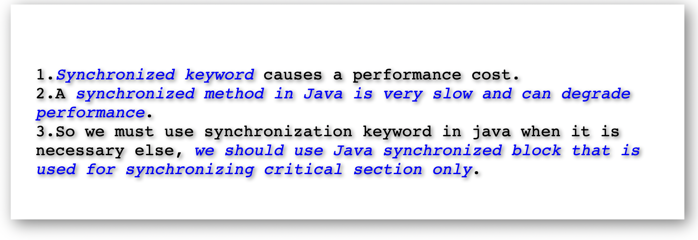
Synchronized block vs Method

Slide 55
Synchronized block vs Method

Slide 56

Static Synchronized Method

Slide 57

Static Synchronized Method

